Slide 1
Properties of Regular Languages
Reading: 4.1 & 4.2

Slide 2
Closure Questions
Is the class of regular languages closed under union?
That is, given 2 regular languages L1 & L2, is
L1 U L2 also regular?

Slide 3
Closure by definition
Regular Languages are closed under
  Union L(r1) or L(r2)
  Concatenation L(r1)∙L(r2)
  Star-closure L(r1*)
These are true by definition of regular expressions
If L1 is regular, then there exists some regular expression r1 which describes it. Same for L2. Then:
  L1 U L2 = L(r1) U L(r2) = r1 + r2
  r1 + r2 is a regular expression and therefore describes a regular language.

Slide 4
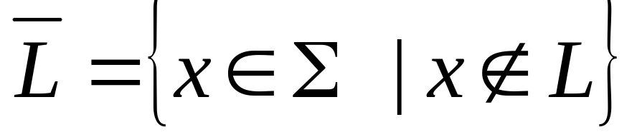
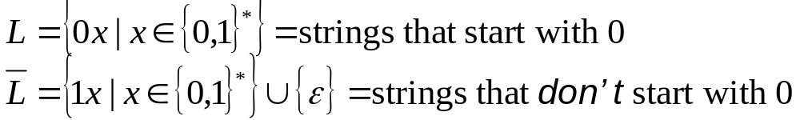
Closure under Complementation
For any language L over an alphabet Σ, the complement of L is
Example:
Given a DFA for any language, it is easy to construct a DFA for its complement

Slide 5
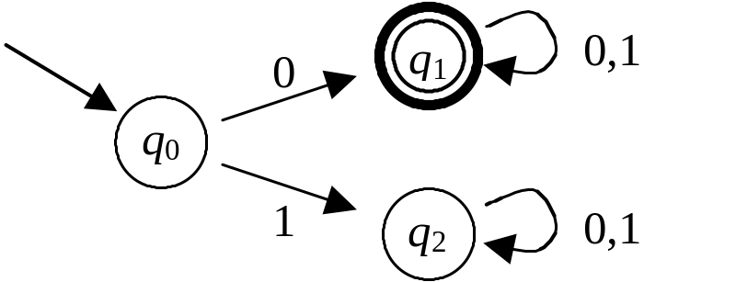
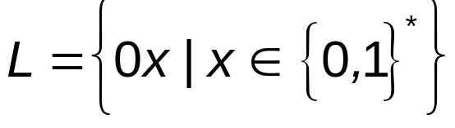
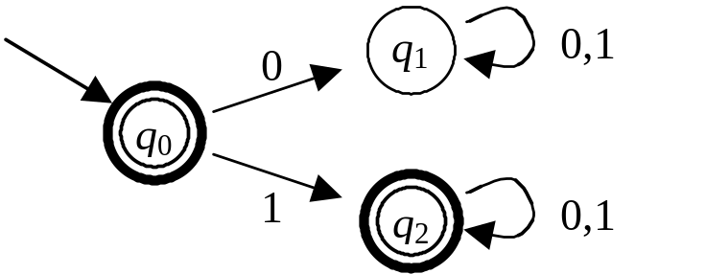
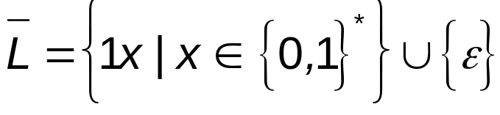
Example

Slide 6
The complement of any regular language is a regular language.
Let L be any regular language
By definition there must be some DFA
M = (Q, Σ, δ, q₀, F) with L(M) = L
Define a new DFA M' = (Q, Σ, δ, q₀, Q-F)
This has the same transition function δ as M, but for any string
x ∈ Σ* it accepts x if and only if M rejects x
Thus L(M') is the complement of L
Because there is a DFA for it, we conclude that the complement of L is regular

Slide 7
Language Intersection
L₁ ∩ L₂ = {x | x ∈ L₁ and x ∈ L₂}
Example:
  L₁ = {0x | x ∈ {0,1}*} = strings that start with 0
  L₂ = {x0 | x ∈ {0,1}*} = strings that end with 0
  L₁ ∩ L₂ = {x ∈ {0,1}* | x starts and ends with 0}
Usually we will consider intersections of languages with the same alphabet, but it works either way
Given two DFAs, it is possible to construct a DFA for the intersection of the two languages

Slide 8
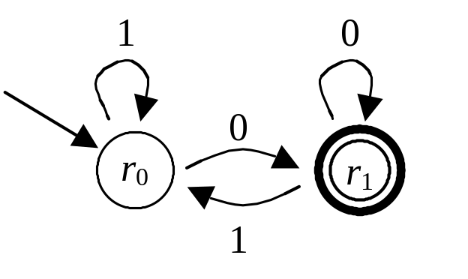

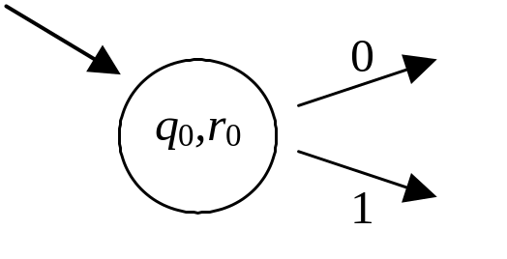
{0x | x ∈ {0,1}*}
{x0 | x ∈ {0,1}*}
We'll make a DFA that keeps track of the pair of states (q_{i}, r_{j}) the two original DFAs are in
Initially, they are both in their start states:

Slide 9
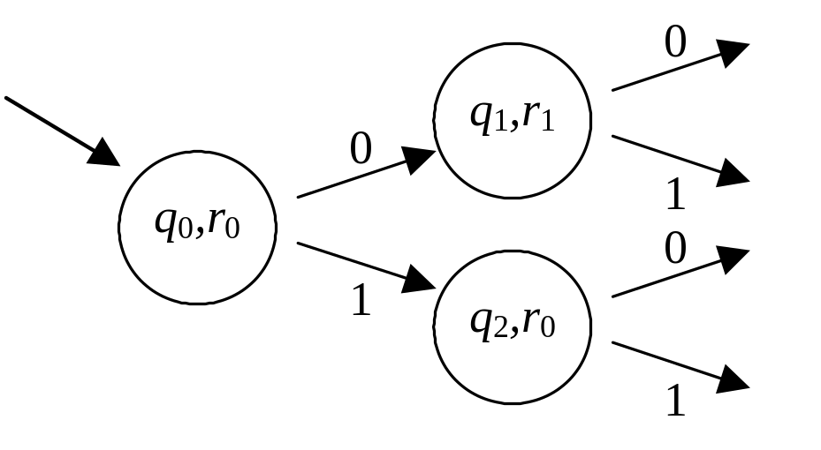
{0x | x ∈ {0,1}*}
{x0 | x ∈ {0,1}*}
Working from there, we keep track of the pair of states (q_{i}, r_{j}):

Slide 10
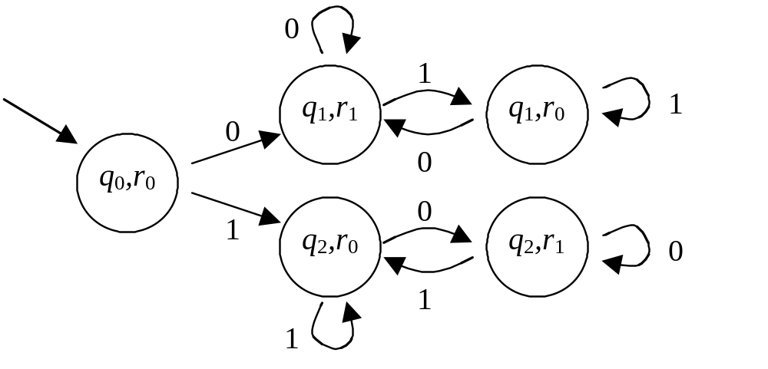
{0x | x ∈ {0,1}*}
{x0 | x ∈ {0,1}*}
Eventually state-pairs repeat; then we're almost done:

Slide 11
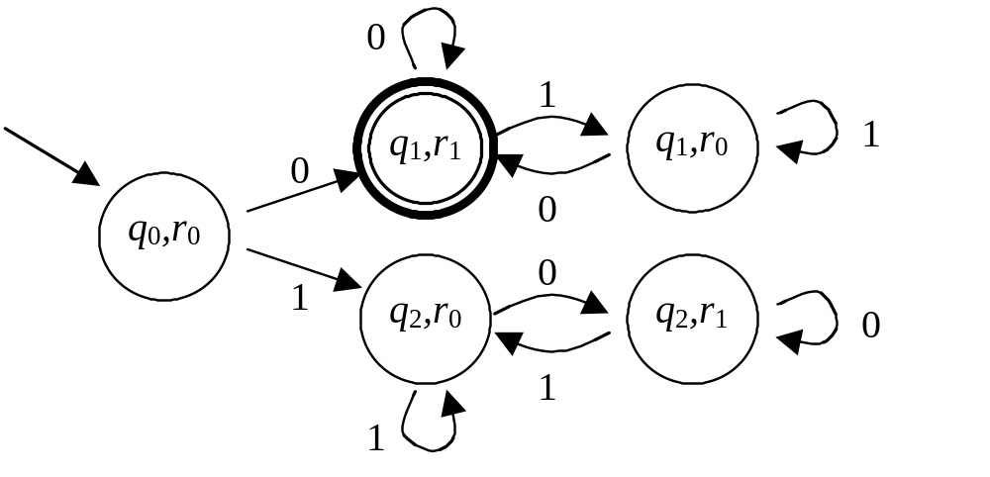
{0x | x ∈ {0,1}*}
{x0 | x ∈ {0,1}*}
For intersection, both original DFAs must accept:

Slide 12
Closure Under Union Proof
DeMorgan’s Law: L1 U L2 = L1 ∩ L2
where L1 and L2 are regular
So L1 and L2 are regular (Closure under complementation)
So L1 ∩ L2 is regular (Closure under intersection)
So L1 ∩ L2 is regular. (Closure under comp.)
So L1 U L2 is regular.

Slide 13
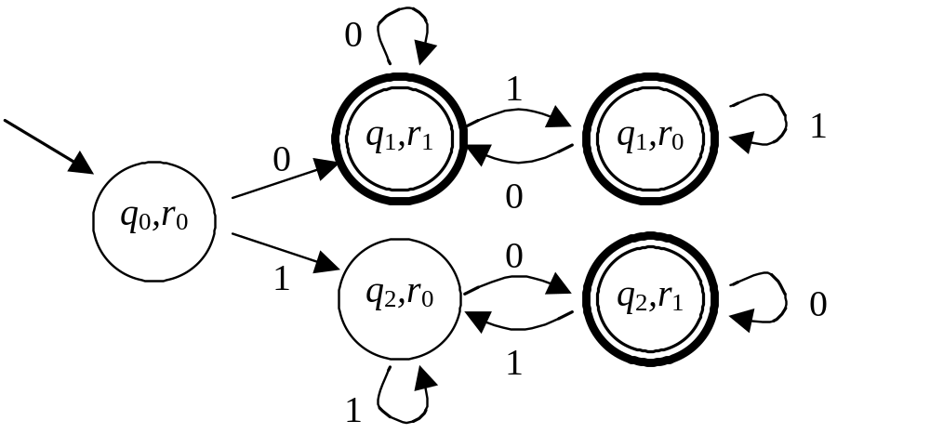
{0x | x ∈ {0,1}*}
{x0 | x ∈ {0,1}*}
For union, at least one original DFA must accept:

Slide 14
Closure Under Difference
L1 – L2 is regular if L1 and L2 are regular
L1 – L2 = L1 ∩ L2
L1 and L2 are regular
Then L2 is regular (closure under comp.)
Then L1 ∩ L2 is regular (closure under inter.)
So L1 – L2 is regular

Slide 15
Closure Under Reversal
If L is regular, then L^{R} is regular.
L is regular so it has a DFA.
DFA for L^{R} can be constructed:
  Make one final state
  Make final state initial
  Make initial state final
  Reverse all arrows.
L^{R} has a DFA, so it is regular.

Slide 16
Homomorphisms
A homomorphism is a function whose domain is an alphabet and range is the star closure of an alphabet.
A homomorphism takes a letter and substitutes it with a string.
The homomorphic image of a language is all strings h(w) when w is a string in the language.

Slide 17
Homomorphism Example
Σ = {a,b}
h(a) = b
h(b) = aac
So h(abaa) = baacbb
The homomorphic image of the language
L = {aba, bba} = {baacb, aacaacb}

Slide 18
Closure Under Homomorphism
If L is regular and h is a homomorphism, then h(L) (the homomorphic image of L) is also regular.
Proof idea: Find the regular expression for L. Exchange each symbol s in the regular expression for h(s). The resulting regular expression describes the homomorphic image of L.
Since it is described with a regular expression, it is a regular language.

Slide 19
Right Quotient of Languages
Let L1 and L2 be languages on the same alphabet. Then the right quotient of L1 with L2 is
  L1 / L2 = {x: xy is in L1 and y is in L2}
In other words, if the string in L1 has a suffix from L2, remove the suffix and the resulting string is in L1 / L2

Slide 20
Closure under right quotient
If L1, L2 are regular then L1 / L2 is regular.
  L1 is regular so it has a FSA.
  For each node in the FSA, see if there is a walk from that node to a final node using a string in L2.
  If so, mark that node final.
So L1 / L2 is regular.

Slide 21
example
L₁ = {a^{n}b^{m} : n ≥ 1, m ≥ 0} ∪ {ba}
L₂ = {b^{m} : m ≥ 1}
L₁/L₂ = {a^{n}b^{m} : n ≥ 1, m ≥ 0}
aaabbbbb ∈ L₁
bbb is suffix
aaabb ∈ L₁/L₂
==> aaab ∈ L₁/L₂
==> aaa ∈ L₁/L₂

Slide 22
Example
L1 = L(a*baa*); L2 = L(ab*)
DFA for L1:
a
a
b
a
q2
q0
q1
b
b
q3
a,b

Slide 23
Example
L1 = L(a*baa*); L2 = L(ab*)
Remove final marking, remember final is q2.
a
a
b
a
q2
q0
q1
b
b
q3
a,b

Slide 24
Example
L1 = L(a*baa*); L2 = L(ab*)
For each node, look for a walk on element of L2 to q2.
a
a
b
a
q2
q0
q1
b
b
q3
a,b

Slide 25
Example
L1 = L(a*baa*); L2 = L(ab*)
DFA for L1/L2:
a
a
b
a
q2
q0
q1
b
b
q3
a,b

Slide 26
Representations
Regular languages can be described by:
  English descriptions (all strings with ab as a substring)
  Set Notation ({ba, ab, bba})
  FSA
  Regular Expression
  Regular Grammars
All but English descriptions are standard representations

Slide 27
Easy Problems for Reg Langs
Membership (Is this string a member of Reg Lang L?)
Is L empty, finite, or infinite?
Equality (Is L1 = L2, for L1,L2 regular)

Slide 28
Equality Algorithm
Is L1 = L2 for L1 and L2 regular?
Define L3 = (L1 ∩ L2) U (L1 ∩ L2)
We know L3 is regular
So, we can test if L3 is empty
L3 = Ø L1 = L2

Slide 29
Example Problems
Draw a FSA for (a+b)a* ∩ baa*
Draw a FSA for (ab+ba)b*ba / b*a*
Show that the family of regular languages is closed under the “nor” operation
Give an algorithm to determine if a regular language is a “palindrome” language
Give an algorithm to determine if L = L* for a regular language L.
Give an algorithm to determine if a regular language has any strings of even length.

